Slide 1
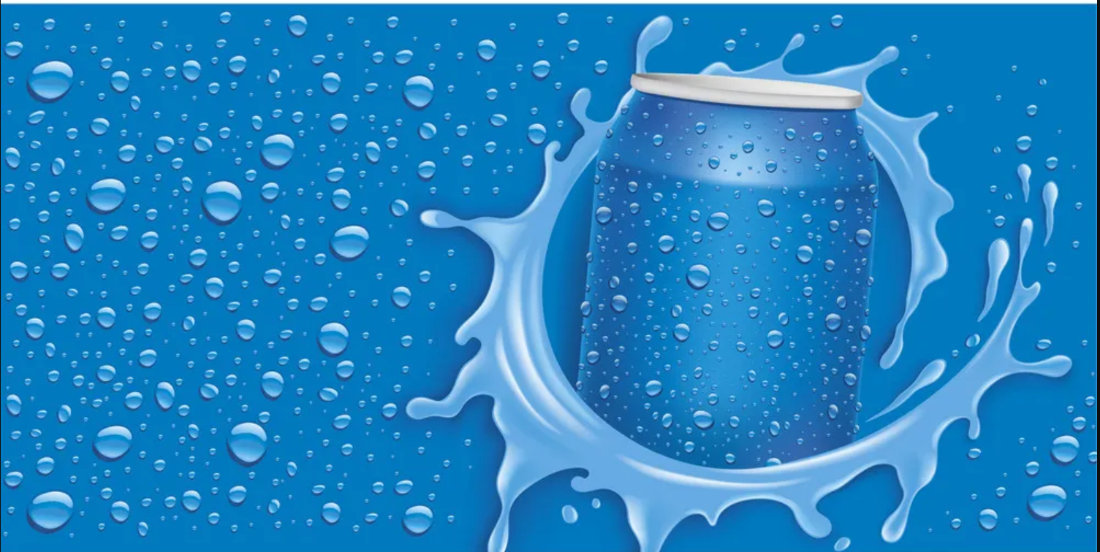

Insights
Food & Beverages

Slide 2
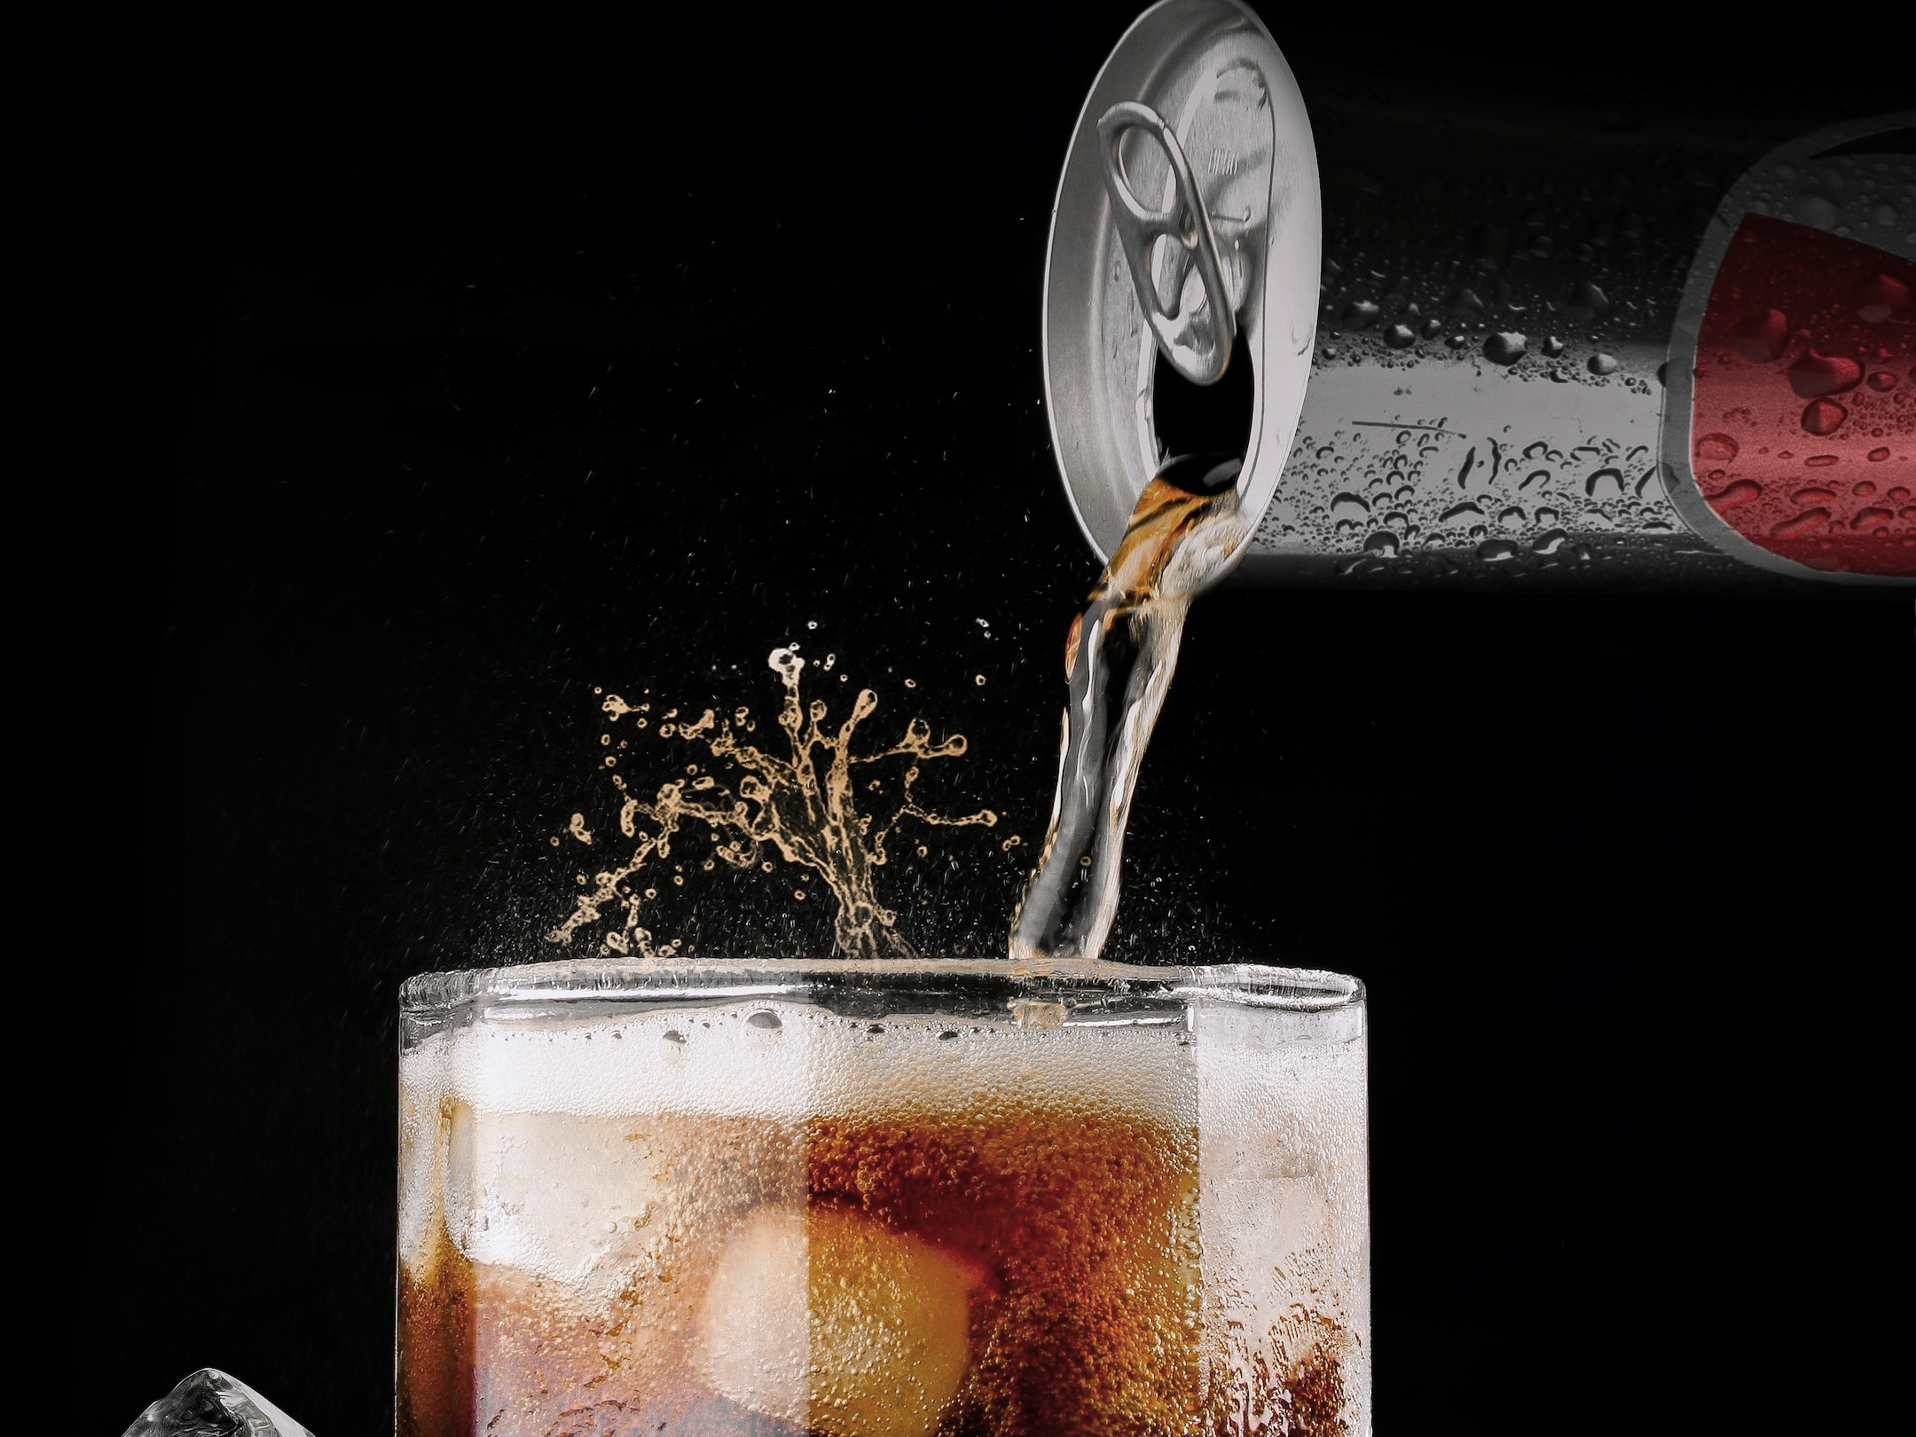

Company Introduction
CodeX is a German beverage company that is aiming to make its mark in the Indian market. A few months ago, they launched their energy drink in 10 cities in India

Slide 3
Task
Task is to provide meaningful insight which marketing team can use to drive actions to increase brand awareness, market share and product development

Slide 4
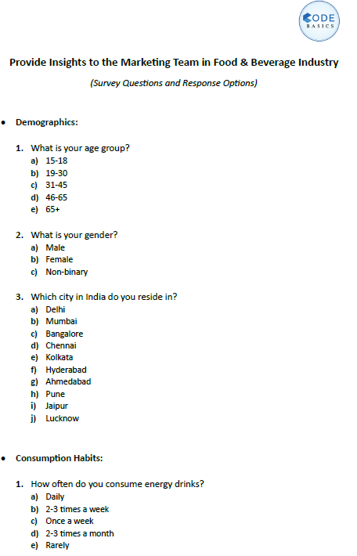
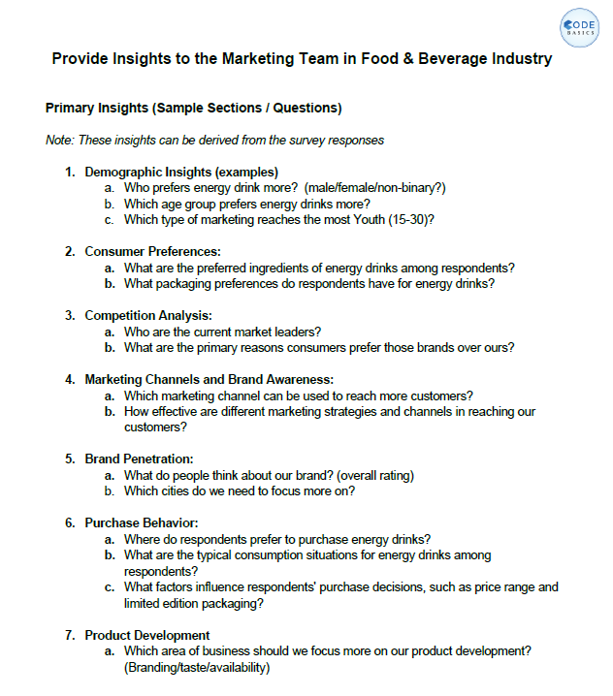
Resources to generate insights
Meta data
Survey questions
Dataset in csv files

Slide 5
Agenda
Primary insights :- Insights derived from the survey questions
Recommendations

Slide 6
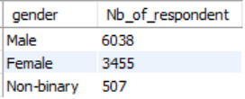
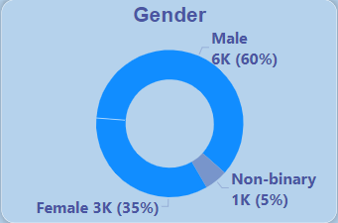
Demographic Insights
Who prefers energy drink more?
Out of 10K respondents , 6K male respondents drink energy drink more

Slide 7
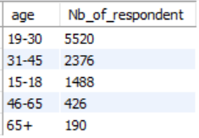
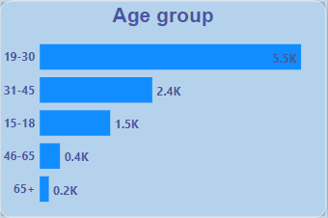
Demographic Insights
Which age group prefers energy drinks more?
Youth between age of 19 to 30 prefer energy drink more

Slide 8
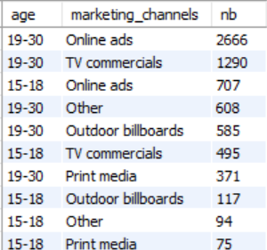
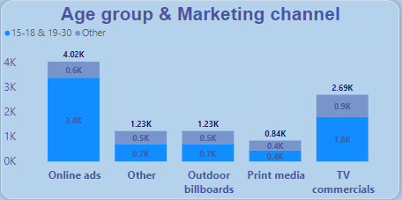
Demographic Insights
Which type of marketing reaches the most Youth (15-30)?
The reach of the advertisement through Online ads is more in youth.

Slide 9
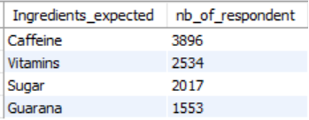
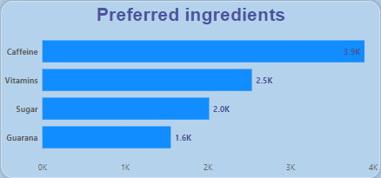
Consumer Preferences
What are the preferred ingredients of energy drinks among respondents?
Preferred ingredients is Caffeine, most of the energy drink have high amount of caffeine which is marketed as providing mental and physical stimulation

Slide 10
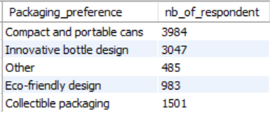
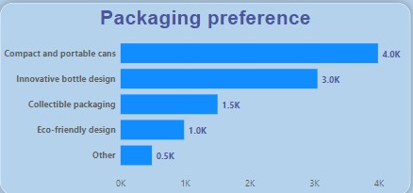
Consumer Preferences
What packaging preferences do respondents have for energy drinks?
Consumer prefer compact and portable cans packing for energy drinks

Slide 11
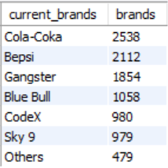
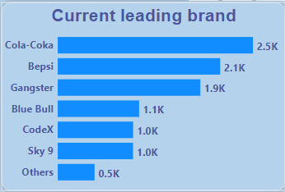
Competition Analysis
Who are the current market leaders?
Cola Coka is leader in energy drink

Slide 12
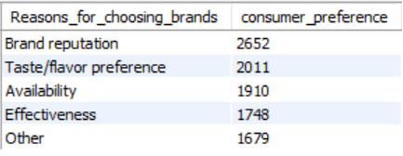
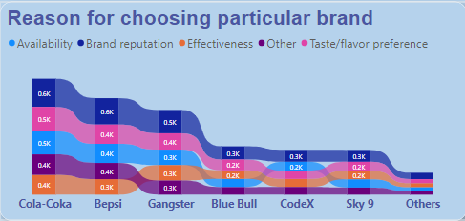
Competition Analysis
What are the primary reasons consumers prefer those brands?
2 major reason to select particular brand is Brand reputation and Taste of the product

Slide 13
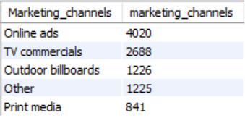
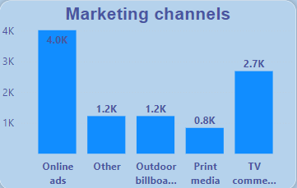
Marketing Channels & Brand Awareness
What marketing channel can be used to reach more customers?
Online ads is the most preferred way to reach customers as now a days most of the consumers spend more time on internet through smart phone.

Slide 14
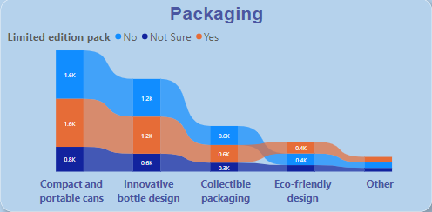

Marketing Channels & Brand Awareness
How effective are different marketing strategies and channels in reaching customers?
Limited edition packs does not influence in buying decision.
Brand & Taste influence buying decision

Slide 15
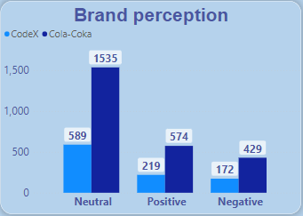
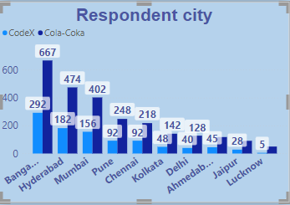
Brand Penetration
What do people think about brand CodeX and which cities they need to focus more on?
Over all perception of people is neutral for brand CodeX
The cities to be focused more is Tier 1 – Bangalore, Hyderabad, Mumbai

Slide 16
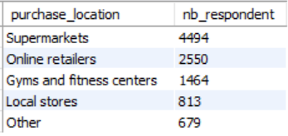
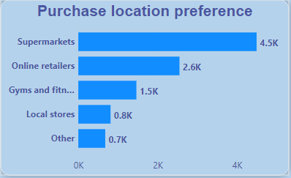
Purchase Behavior
Where do respondents prefer to purchase energy drinks?
Most of the user prefer to purchase energy drink from Supermarkets

Slide 17
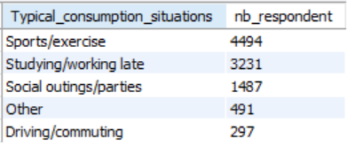
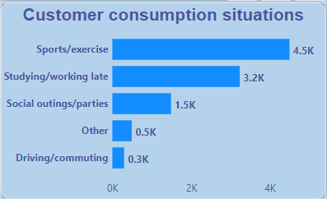
Purchase Behavior
What are the typical consumption situations for energy drinks among respondents?
Energy drink is more preferred by people are doing sports and people who do late night study.

Slide 18
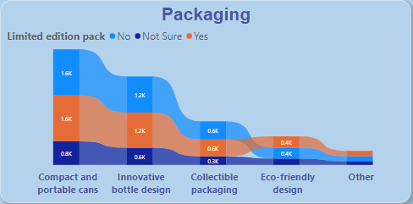
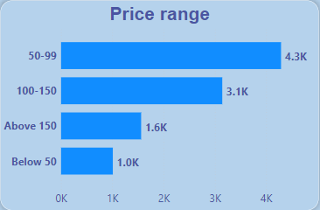
Purchase Behavior
What factors influence respondents purchase decisions , such as price range and limited edition packaging?
Packaging & limited edition packaging does not influence much on buying decision as most of the respondents are having neutral view.
Its taste , price which influence buying decision.

Slide 19
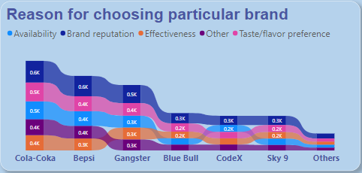
Product development
Which area of business should we focus more on product development?
Brand is created based on the quality of the product.
CodeX must concentrate more on taste of the product.

Slide 20
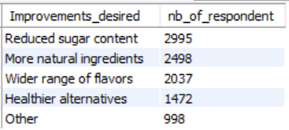
Recommendation
What immediate improvements can we bring to the product?
Over all expectation of consumer from energy drink is it should have less sugar.
Plant based ingredients like Ginseng, Green coffee bean extract, Yerba mate.

Slide 21
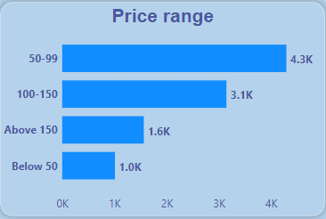
Recommendation
What should be ideal price of our products?
My suggestion would be to keep the price between 100 to 120. If taste is good then consumer may feel worth of buying at price more then 100.

Slide 22
Recommendation
What kind of marketing campaigns , offers, and discounts we can run?
Codex can organize online gaming competition in metro cities and can invite the champions of the online game. For refreshment this champions must be given CodeX energy drink as mostly followers try to consume same product what there champions are using.

Slide 23
Recommendation
Who can be a brand ambassador, and why?
MS Dhoni- “The Finisher” can be brand ambassador, the energy he shows while running between the wickets for each single run during crucial matches and the way he finishes the match is fabulous.

Slide 24
Recommendation
Who should be our target audience ,and why?
The target audience should be youth between the age of 15 to 30 as this age group is either focused on physical activity or work late night in office and they need something to drink to keep going in there daily activity.

Slide 25
Thanks for your time

